Slide 1
Design and Analysis of Algorithms
CS602
Lecture 2
Divide and Conquer Paradigm – I
- Closest Pair of Points

Slide 2
Homework from last class
The seat allocation algorithm for the single merit list.?
Can you now tackle the problem of multiple merit lists ?

Slide 3





Multiple Merit Lists
19 IITs
31 NITs
18 IIITs
33989 seats
1304127 candidates
18 OtherGFTIs

Slide 4
Fairness
Choice list of Mohan
p
q
p
Mohan
q
Ram
Merit list
of programme q
Ram
Mohan

Slide 5
How to tackle Multiple Merit Lists using “Single Merit list algorithm”

Slide 6









A common man’s algorithm
Allocation
IITs
Allocation
NITs
No
Should we remove from NITs for future ?
$r$ →
Repeat
$q$ →
I prefer $p$to $q$.
$p$ or $q$ ?
$p$ →
$$p$$
$$r$$
$$q$$
Choice list for IITs
Choice list for NITs

Slide 7

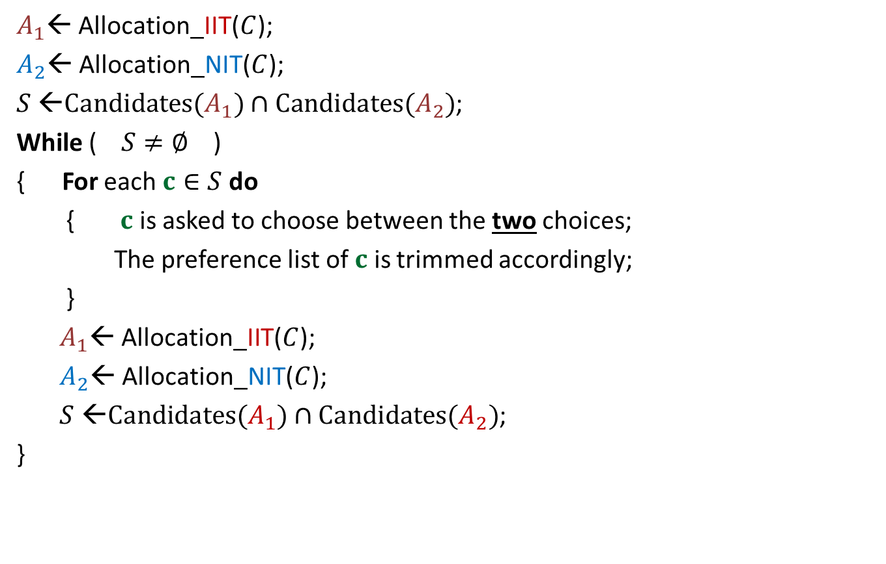


A common man’s algorithm
$A_{1}$← Allocation_IIT($C$);
$A_{2}$← Allocation_NIT($C$);
$S$ ←$Candidates(A_{1})∩Candidates(A_{2})$;
While ( $S≠∅$ )
{ For each $c∈S$ do
{ $c$ is asked to choose between the two choices;
The preference list of $c$ is trimmed accordingly;
}
$A_{1}$← Allocation_IIT($C$);
$A_{2}$← Allocation_NIT($C$);
$S$ ←$Candidates(A_{1})∩Candidates(A_{2})$;
}
Round ← $1$
and
Round $≤5$
)
Round ← Round + $1$

Slide 8
Homework
Transform the common man’s algorithm to just 1 round ?
Analyse the common man’s algorithm. In particular, try to prove its correctness.

Slide 9
Divide and Conquer paradigm

Slide 10
An Overview
Divide the problem instance into two or more instances of the same problem.
Solve each smaller instance recursively (base case suitably defined).
Combine the solutions of the smaller instances
to get the solution of the original instance.
Notes:
How do we solve any problem in this paradigm ?
The 3rd step (Combine step) is usually the main nontrivial step in the design of an algorithm using divide and conquer strategy

Slide 11

Example Problems
Merge Sort
Multiplication of two $n$-bit integers.
Counting the number of inversions in an array.
Finding median of $n$numbers in linear time.

Slide 12
Divide and Conquer Paradigm (Advanced Problems)
Geometric Problems:
Closest Pair Distance
Non-dominated Points
Convex Hull
Number theoretic Problem
Multiplication of 2 Polynomials

Slide 13





Distance between 2 points
$$(x_{j},y_{j})$$
O($1$) time
$$(x_{i},y_{i})$$
$$y$$
$$x$$

Slide 14

The Closest Pair Distance Problem
$$δ$$
$$y$$
$$x$$

Slide 15
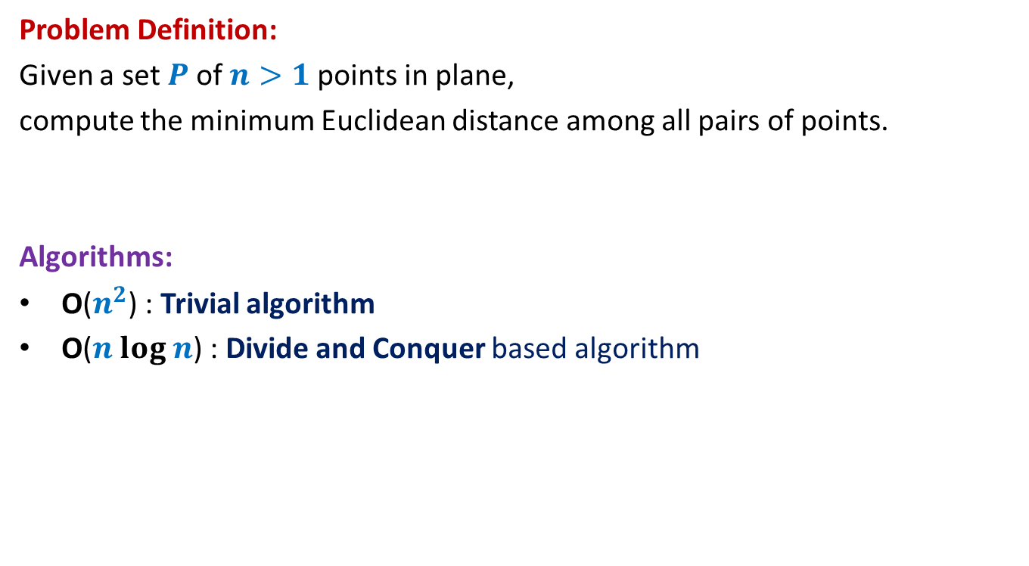
The Closest Pair Distance Problem
Problem Definition:
Given a set $P$of $n>1$points in plane,
compute the minimum Euclidean distance among all pairs of points.
Algorithms:
O($n^{2}$) : Trivial algorithm
O($n log n$) : Divide and Conquer based algorithm
We shall use 3 tools to design this algorithm. Please make sure you internalize them well.

Slide 16

Question 1
Tool 1
A fact from high school geometry
Fact :
Let $p=(x_{1},y_{1})$ and $q=(x_{2},y_{2})$ be any two points.
If $\left|x_{1}−x_{2}\right|>δ$, distance($p,q$) $>δ$
If $\left|y_{1}−y_{2}\right|>δ$, distance($p,q$) $>δ$

Slide 17
A discrete math exercise
Exercise:
What is the maximum number of points that can be placed in a unit square
such that each pair of them is separated by distance at least 1 ?
1
Notes:
If there are more than 4 points in the unit square,
at least one of the four small squares will have more than 1 points.

Slide 18




A discrete math exercise
Tool 2
Exercise:
What is the maximum number of points that can be placed in a unit square
such that each pair of them is separated by distance at least 1 ?
$$δ−$$
$$δ$$
Answer: 4.
$$\frac{1}{\sqrt{2}}$$
1
$$δ$$
Notes:
If there are more than 4 points in the unit square,
at least one of the four small squares will have more than 1 points.

Slide 19
Question 2
Tool 3
A fundamental question about data structure ?
Question:
While solving an algorithmic problem, when do we feel the need of an
efficient data structure ?
Answer:
when the algorithm involves “many” operations of same type on a given data.
Notes:
For example, it is worth sorting an array only if there are going to be many search queries on it.
Let us see if you can use this principle to solve this problem.

Slide 20
a Divide and Conquer algorithm for
Closest Pair Distance

Slide 21


The divide step
$$y$$
$$x$$

Slide 22



Solving the problem in 1-dimension
Median of $n$ points.
$$y$$
$$x$$
Left half set
$⌈\frac{n}{2}⌉$points
$⌊\frac{n}{2}⌋$points
Right half set

Slide 23




Solving the problem in 1-dimension
We can not afford to compute distance between each point of the left half set and each point of the right half set.
We need to consider only one point from the left half set
and one point from the right half set. Can you spot them ?
T($n$) = c $n$ + 2 T($n$/2)
$=O$($n\log{n}$)
$$δ_{L}$$
$$δ_{R}$$
$$x$$
Left half set
$⌈\frac{n}{2}⌉$points
$⌊\frac{n}{2}⌋$points
Right half set

Slide 24
How to extend to 2-dimensions
$$x$$

Slide 25
The divide step
$$y$$
$$x$$

Slide 26



Solving the 2 smaller instances
$$δ_{L}$$
$$δ_{R}$$
Left half set
$⌈\frac{n}{2}⌉$points
$δ$ ← min($δ_{L}{,δ}_{R}$)
$⌊\frac{n}{2}⌋$points
Right half set
Notes:
1. Compute the closest pair distance of the left half set
2. Let it be Delta_L.
3.Compute the closest pair distance of the right half set
4. Let it be Delta_R.

Slide 27



The combine step
Tool 1
$$>δ$$
$$δ_{L}$$
$$δ_{R}$$
$$δ$$
$$δ$$
$δ$ ← min($δ_{L}{,δ}_{R}$)
Notes:
Which points do we need to focus on for the closest pairs ?
The total number of these pairs are Theta(n^2).
How to do it efficiently ?
Exploit the geometric aspect of the problem.
Time to use Hint 1.
For a point in the left half set, if its distance to any point in the right set is less than delta, can we infer anything about its x-coordinate.
: Its x-coordinate can not be less than the x-coordinate of the other point by more than delta.

Slide 28


The combine step
Potentially $Θ(n)$ points in each strip
$$δ_{L}$$
$$δ_{R}$$
$$δ$$
$$δ$$
$δ$ ← min($δ_{L}{,δ}_{R}$)
Notes:
But there may still be $Θ(n)$ points in each of these strips.
So what to do ?

Slide 29


The combine step
Do we need to compute distance from $p$
to each point of the red strip ?
Tool 1
$$δ_{L}$$
$$p$$
$$δ_{R}$$
$$δ$$
$$δ$$
$δ$ ← min($δ_{L}{,δ}_{R}$)
Notes:
1. Only the points lying in these 2 red squares are relevant as far as $p$ is concerned.
2. Time to use Hint 2
3. Surely not more than 8.
-----------------------------
1. How to find the points in these red square for point $p$?

Slide 30

The combine step
Tool 1
$$δ_{L}$$
$$δ$$
$$p$$
$$δ$$
$$δ_{R}$$
$$δ$$
$$δ$$
$δ$ ← min($δ_{L}{,δ}_{R}$)
Notes:
1. Only the points lying in these 2 red squares are relevant as far as $p$ is concerned.
2. Time to use Hint 2
3. Surely not more than 8.
-----------------------------
1. How to find the points in these red square for point $p$?

Slide 31

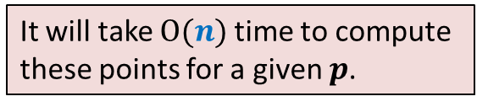
The combine step
But we need to do this task for each point of left strip.
How many points lie in these 2 squares ?
Tool 2
$$δ_{L}$$
It will take $O(n)$time to compute
these points for a given $p$.
$O(1)$points only
$$δ$$
$$p$$
$$δ$$
$$δ_{R}$$
$$δ$$
$$δ$$
$δ$ ← min($δ_{L}{,δ}_{R}$)
Notes:
1. Only the points lying in these 2 red squares are relevant as far as $p$ is concerned.
2. Time to use Hint 2
3. Surely not more than 8.
-----------------------------
1. How to find the points in these red square for point $p$?

Slide 32
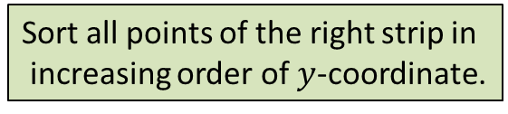






The combine step
But we need to do this task for each point of left strip.
Tool 3
$$δ$$
$$δ$$
$$δ$$
$$δ$$
Sort all points of the right strip in
increasing order of $y$-coordinate.
$$δ_{L}$$
$$δ$$
$$δ$$
$$δ$$
$$(x^{′},y^{′})$$
Binary search for ($y^{′}+δ$)
$$p$$
$$δ$$
Binary search for ($y^{′}−δ$)
$$δ_{R}$$
$$δ$$
$$δ$$
$δ$ ← min($δ_{L}{,δ}_{R}$)

Slide 33


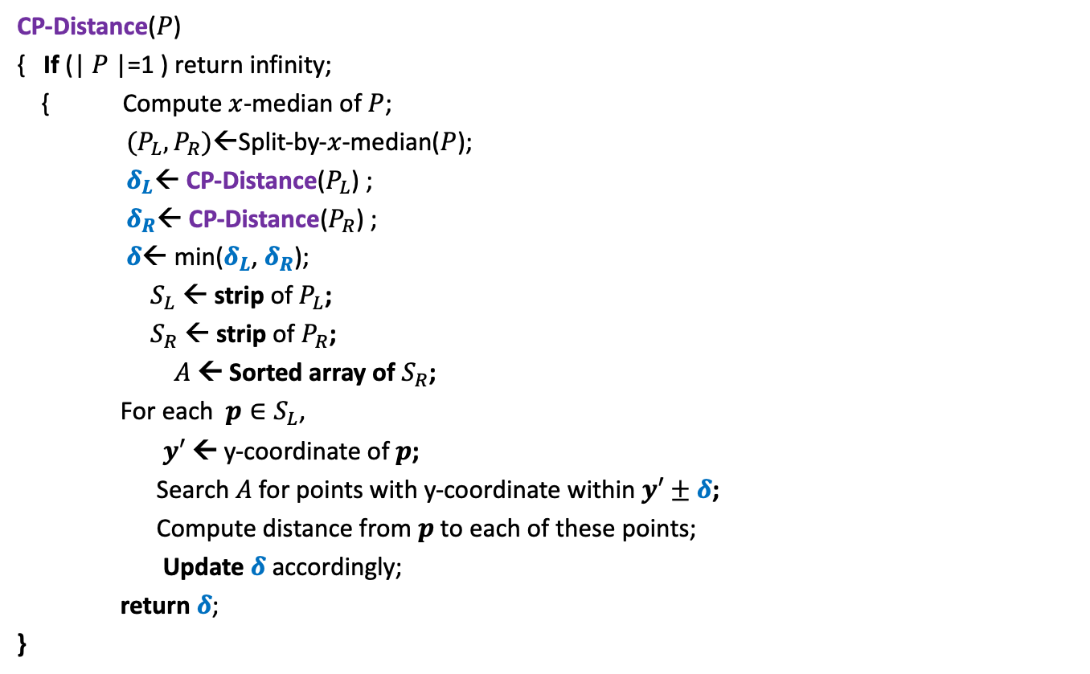
Divide and Conquer based algorithm
CP-Distance($P$)
{ If (| $P$|=1 ) return infinity;
{ Compute $x$-median of $P$;
$(P_{L},P_{R})$←Split-by-$x$-median($P$);
$δ_{L}$← CP-Distance($P_{L}$) ;
$δ_{R}$← CP-Distance($P_{R}$) ;
$δ$← min($δ_{L}$, $δ_{R}$);
$S_{L}$ ← strip of $P_{L}$;
$S_{R}$ ← strip of $P_{R}$;
$A$← Sorted array of $S_{R}$;
For each $p∈S_{L}$,
$y′$ ← y-coordinate of $p$;
Search $A$for points with y-coordinate within $y′±δ$;
Compute distance from $p$to each of these points;
Update $δ$ accordingly;
return $δ$;
}
$O(\left|P\right|)$ + 2 T(|$P$|/2) time
Divide step
$O(\left|P\right| \log{|P|})$ time
Combine/conquer step

Slide 34
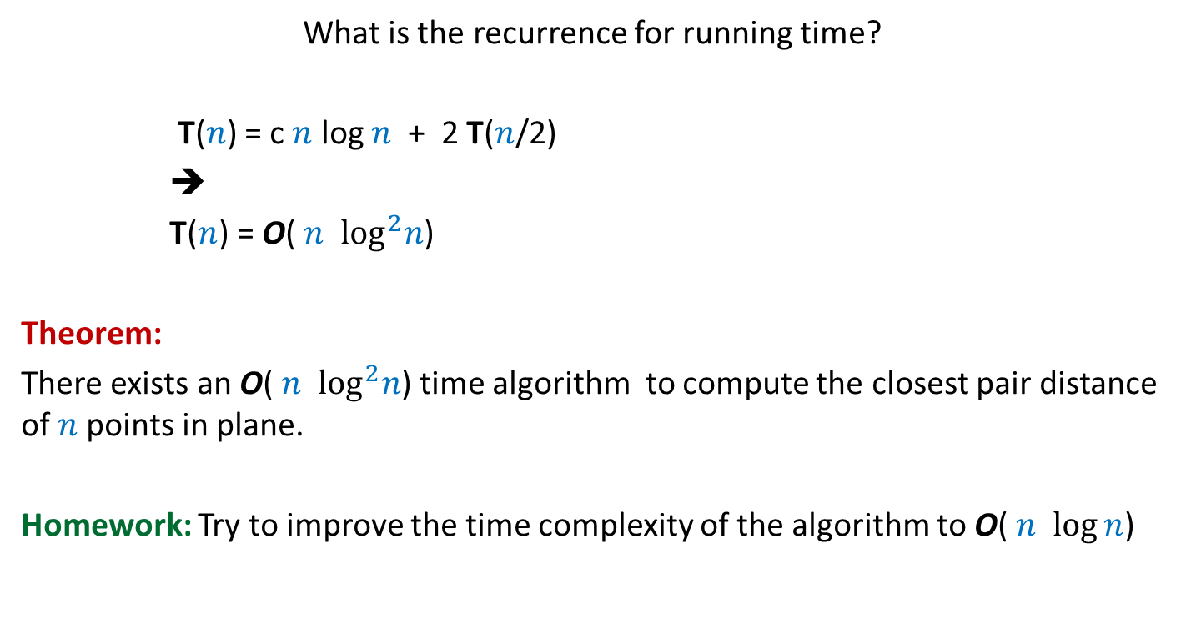
Running time of the algorithm
What is the recurrence for running time?
T($n$) = c $n$ log $n$ + 2 T($n$/2)
➔
T($n$) = O( $n$ $\log^{2}n$)
Theorem:
There exists an O( $n$ $\log^{2}n$) time algorithm to compute the closest pair distance of $n$points in plane.
Homework: Try to improve the time complexity of the algorithm to O( $n$ $\log{n}$)

